Slide 1
Local Maternity System Analytics 2020-2024
Request for support from Shared Health and Care Analytics Board
If teams, organisations and systems are to improve, they must know where they are, how they compare to others and to the best, and how they are improving over time. Collecting the right information and making the best use of it is therefore vital.
Notes:
Review of data
“Clinicians from across the Local Maternity System need to come together regularly to review data, including patient experience data, both at Local Maternity System and unit level. This involves comparing and benchmarking, and using the conclusions to inform service improvement.”
Continuous quality improvement
“Continuously measure the quality of services and use the data to identify and implement service improvements.”
Measuring transformation
“[Increasing choice and personalisation to deliver the Better Births vision] will require qualitative and quantitative data on service user experience.” key metrics: use of personalised care plans, women receiving continuity of carer,

Slide 2
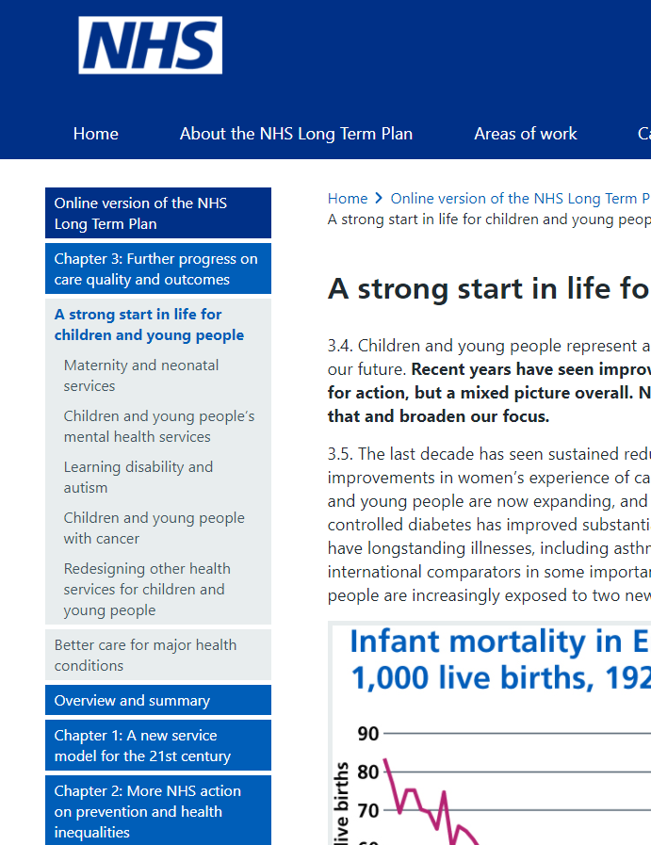
Local Maternity System Analytics 2020-2024
National Maternity Policy
Better Births (2016)
If teams, organisations and systems are to improve, they must know where they are, how they compare to others and to the best, and how they are improving over time. Collecting the right information and making the best use of it is therefore vital.
Review of data
Continuous quality improvement
Measuring transformation
Long Term Plan (2019)
Notes:
Review of data
“Clinicians from across the Local Maternity System need to come together regularly to review data, including patient experience data, both at Local Maternity System and unit level. This involves comparing and benchmarking, and using the conclusions to inform service improvement.”
Continuous quality improvement
“Continuously measure the quality of services and use the data to identify and implement service improvements.”
Measuring transformation
“[Increasing choice and personalisation to deliver the Better Births vision] will require qualitative and quantitative data on service user experience.” key metrics: use of personalised care plans, women receiving continuity of carer,

Slide 3
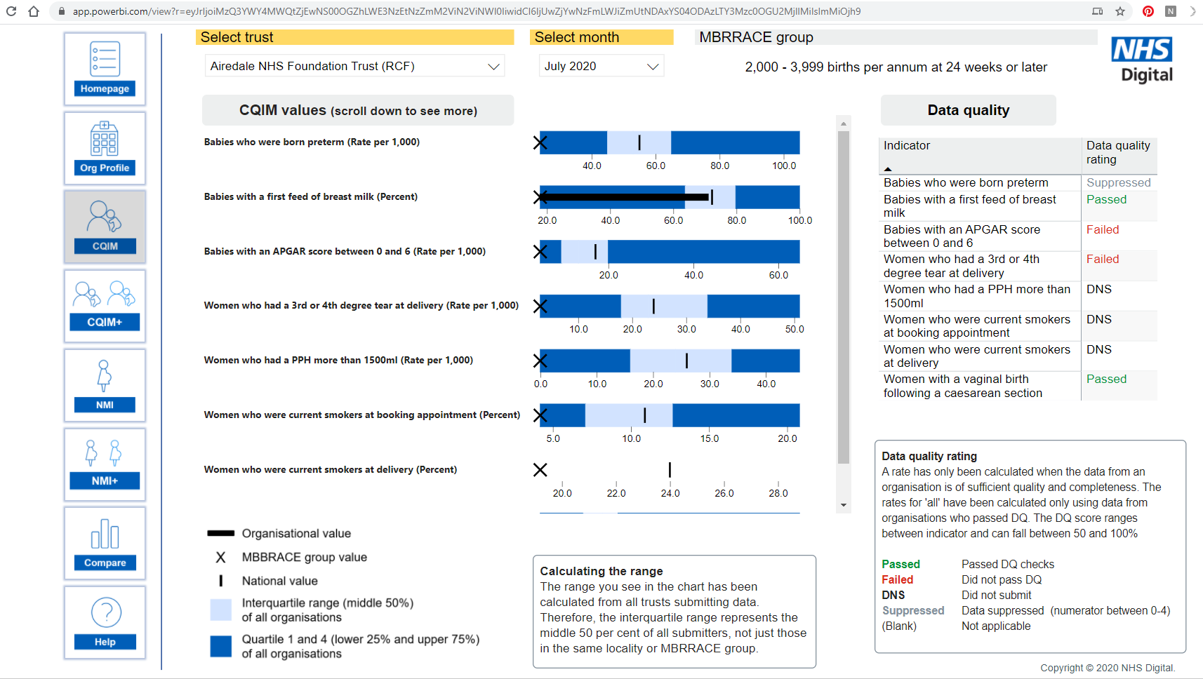
Local Maternity System Alternative Approaches
National Dashboard
Notes:
Review of data
“Clinicians from across the Local Maternity System need to come together regularly to review data, including patient experience data, both at Local Maternity System and unit level. This involves comparing and benchmarking, and using the conclusions to inform service improvement.”
Continuous quality improvement
“Continuously measure the quality of services and use the data to identify and implement service improvements.”
Measuring transformation
“[Increasing choice and personalisation to deliver the Better Births vision] will require qualitative and quantitative data on service user experience.” key metrics: use of personalised care plans, women receiving continuity of carer,

Slide 4
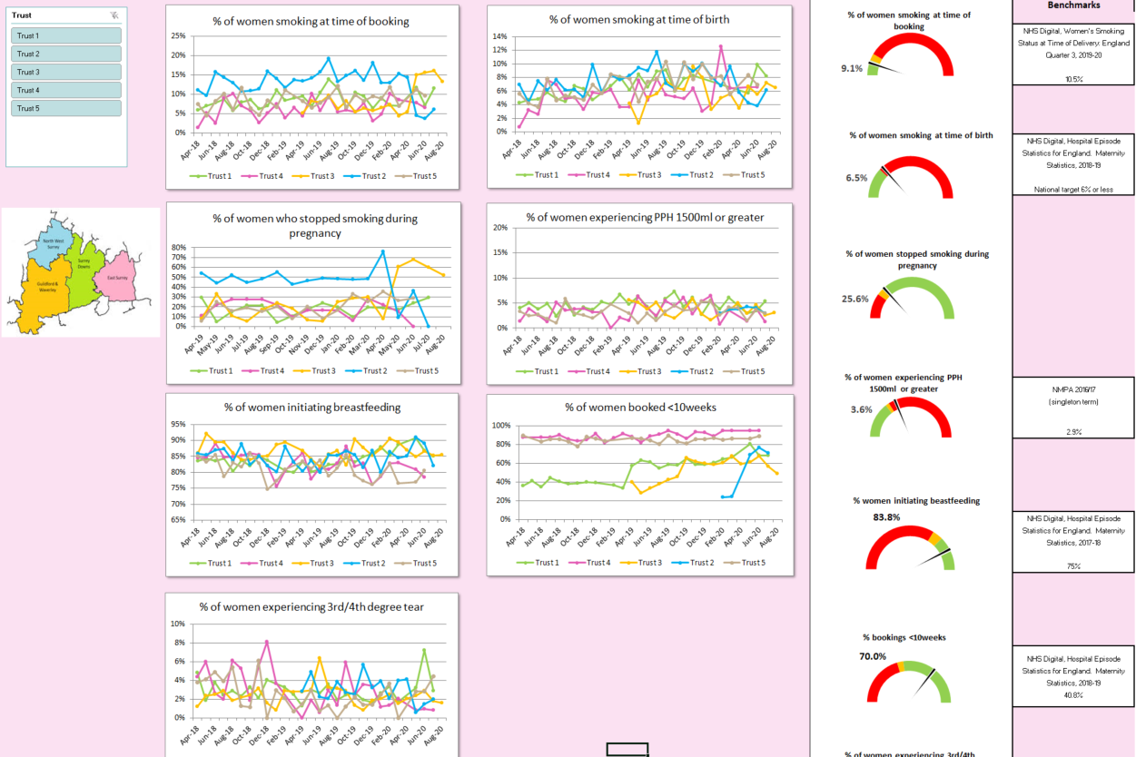
Local Maternity System Alternative Approaches
Local LMS Dashboard
Notes:
Review of data
“Clinicians from across the Local Maternity System need to come together regularly to review data, including patient experience data, both at Local Maternity System and unit level. This involves comparing and benchmarking, and using the conclusions to inform service improvement.”
Continuous quality improvement
“Continuously measure the quality of services and use the data to identify and implement service improvements.”
Measuring transformation
“[Increasing choice and personalisation to deliver the Better Births vision] will require qualitative and quantitative data on service user experience.” key metrics: use of personalised care plans, women receiving continuity of carer,

Slide 5
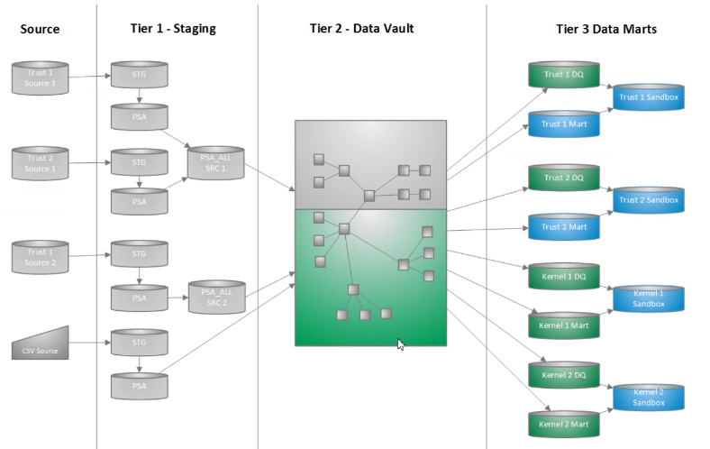
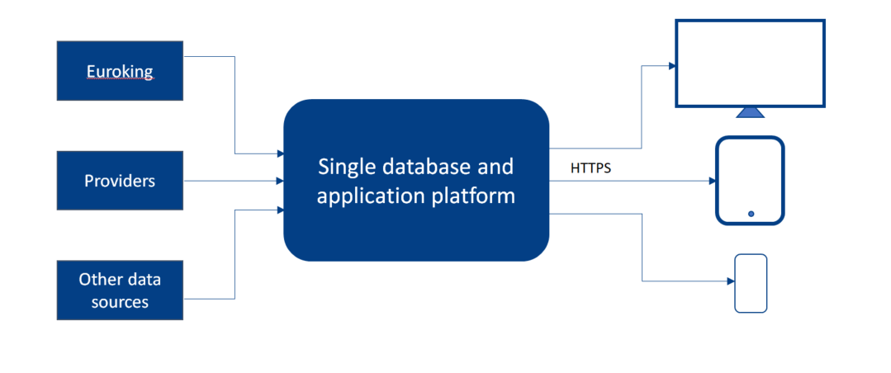
Local Maternity System Outline Architecture
Euroking
PAS

Slide 6
Local Maternity System Analytics 2020-2024
Request for support from Shared Health and Care Analytics Board
Situation
Kent & Medway LMS immature in analytical capability. Increasing expectations from NHS E&I on use of data in maternity services
Assessment
Kernel now established as a developing single data repository for K&M
Resource in place to March 21 in LMS
Background
Analytics strategy developing in Kent & Medway.
Move from KID to kernel has involved uncertainty across system
Recommendations
SHcAB to prioritise maternity analytics while LMS programme team in place
SHcAB to facilitate senior Trust representation at maternity data group meetings and support effective governance
SHcAB to ensure maternity data flows to Kernel as a priority for those Trusts signed up to joint data control
Notes:
Review of data
“Clinicians from across the Local Maternity System need to come together regularly to review data, including patient experience data, both at Local Maternity System and unit level. This involves comparing and benchmarking, and using the conclusions to inform service improvement.”
Continuous quality improvement
“Continuously measure the quality of services and use the data to identify and implement service improvements.”
Measuring transformation
“[Increasing choice and personalisation to deliver the Better Births vision] will require qualitative and quantitative data on service user experience.” key metrics: use of personalised care plans, women receiving continuity of carer,

