Slide 1
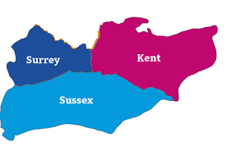
Dr Melanie Rees-Roberts, Research Programme Manager Director: Prof Stephen Peckham NHS Host: Sussex Partnership NHS Foundation Trust
ARCKentSurreySussex@sussexpartnership.nhs.uk
https:arc-kss.nihr.ac.uk
Follow us on @arc_kss

Slide 2
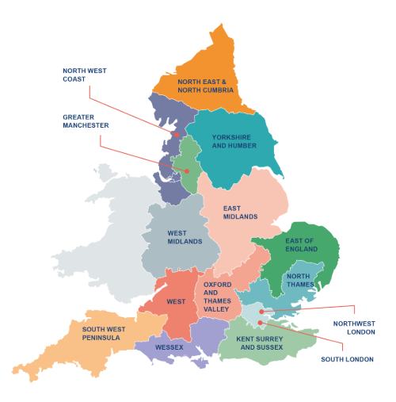
What are ARCs and what do we do?
National Institute for Health Research (NIHR) funding – research infrastructure
develop regionally-based research partnerships
between local providers of NHS services, local authorities, health and social care organisations, universities, other NIHR bodies.
to improve health and social care for people, patients and service users through implementation of applied health and social care research into practice
Notes:
CLAHRC stands for Collaboration for Leadership in Applied Health Research and Care. The NIHR CLAHRC funding is to develop regionally-based partnerships between local providers of NHS services (such as hospital trusts) and universities. There are currently 13 CLAHRCs across England, and each CLAHRC focuses on different areas of research and improvement. However, currently southeast England does not have a CLAHRC.
There is a possibility for Kent, Surrey and Sussex to bid for the next round of CLAHRC funding in early 2018. For the bid, we need to identify health and social care areas where we have regional expertise. Through working with universities and NHS trusts, a number of areas of expertise have already been identified.

Slide 3
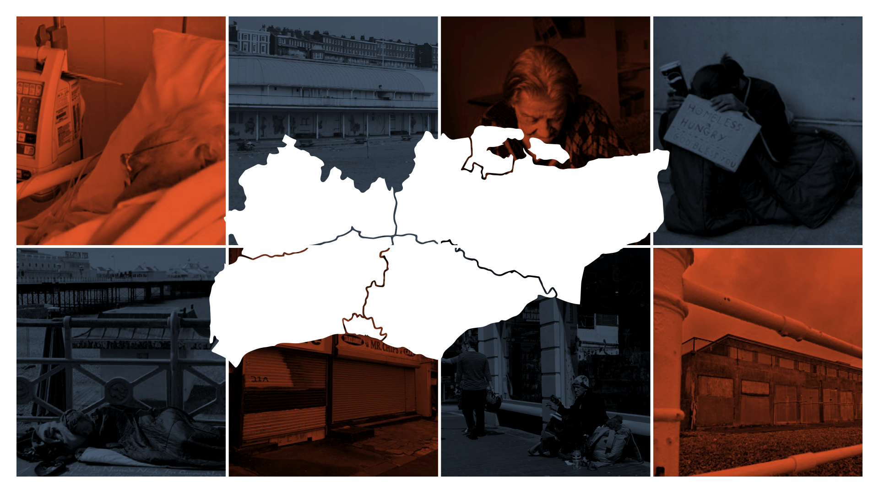
Why an ARC in Kent, Surrey and Sussex?
Our strategy and aims based on a scoping of local need:
POPULATION GROWTH
Population of nearly 4.5 million expected to grow by 0.5 million over the next decade
Highest growth rate of people aged 65+ in England outside London
HEALTH AND CARE CHALLENGES
High rates of hospital admissions for self-harm amongst young people
High levels of social deprivation in many coastal towns
Highest levels of people living with dementia in England
WORKFORCE
Dispersed population in smaller towns and villages with dispersed health and social care system
Major workforce and organisational sustainability problems
Kent South Coast CCG has 2nd highest ratio of people aged 65+ per GP in England
RESEARCH CAPACITY
Strong academic research base with some pockets of strong NHS research
Low level of high quality health and social care research across the region
Only one NIHR Senior Investigator in SE region
RESEARCH ACTIVITY
NHS organisations have 7.2% of CRN registered studies in England
However low number of NIHR bids compared to other regions
RESEARCH INVESTMENT
Problem of funding to support research infrastructure in region

Slide 4
Core ARC KSS activities
Collaboration and support for applied research to enable evidence into practice and transformation of service delivery, that will benefit patients, the community and the NHS and Social Care.
Capacity building in health and social care research
Build and grow a sustainable research workforce - clinical and academic environments – ARC KSS academy
Transforming research capacity through learning and development
Applied Health/Social Care Research
Research themes and national themes – research and implementation
Increase the research funding and outputs of impact in the region
Engaging and involving local communities, patients and the wider public
Catalysing co-production and co-design at the heart of ARC KSS activity
Implementation of research into practice
Communities of Practice: “spread and adoption” of evidence into practice
Measuring progress: dissemination of knowledge including within STPs.

Slide 5
Core ARC KSS activities
Co-ordination, facilitation, management and support for applied research across the region to enable:
Capacity building in health and social care research
build and grow a sustainable research workforce with expertise in clinical and academic environments – ARC KSS academy
evidence into practice and transformation of service delivery, that will benefit patients, the community and the NHS and Social Care.
Applied Health/Social Care Research
Develop core research themes and projects
Develop national theme in social care
Increase the research funding and outputs of impact in the region
Engaging and involving local communities, patients and the wider public
Wide range of NHS, university, public sector and charity partners
Co-production of research
Implementation of research into practice
Catalysing co-design: co-production at the heart of ARC KSS activity
Communities of Practice: “spread and adoption” of evidence into practice
Developing change capability: Transforming research capacity through learning and development
Measuring progress: dissemination of knowledge including within STPs.

Slide 6
Supporting the use of data to inform care
ARC KSS is keen to support the use of data to inform care through evaluation and research – working collaboratively to address local and regional issues
Recently been funded by NIHR to conduct a project to ‘unlock data for public health research’
Form a working community - challenges, barriers and solutions for understanding complex datasets, developing skills and methods.
data scientists at universities
Local Authority Public Health teams
teams who run or have skills in linked datasets
public representatives
Funding for 6-months for 2 Public Health analysts in Kent and Sussex to be actively supported and trained by university data scientists to work on problems focused on:
linking complex sources of data together (Kent)
using linked health and care data to identify earlier opportunities to keep people well and independent for longer (Sussex).
Hold discussion groups with members of the public to understand more about their views around the use of health data and other forms of data that might be linked by ICS
advise ICS plans for including the public in decision-making around data access and priorities for data projects, and how to be clear and trustworthy about data use.

Slide 7
Public engagement around integrated datasets: Why and how?
Dr Elizabeth Ford
Senior Lecturer in Primary Care Research
Brighton and Sussex Medical School
University of Sussex, Brighton, UK

Slide 8
My research background
PhD in clinical health psychology, postdocs in psychiatric epidemiology, primary care epidemiology.
Working on analysing anonymised GP patient records data for the last 10 years (from Clinical Research Practice Datalink)
Interest in methods (machine learning, natural language processing) and governance for analysing clinical free text from NHS letters, reports and clinic notes.
Public engagement on uses of patient data – e.g. interviews, focus groups, citizens’ jury
Collaborations with physicists, mathematicians & computer scientists to develop new methods to analyse patient data and detect conditions:
http://www.bsms.ac.uk/astrodem
Currently: Senior Lecturer in Primary Care Research at BSMS

Slide 9
Why use medical text for research?
Some clinical information is only found in text – there is little coding structure for:
Mental health records
Hospital Discharge Letters
Pathology Reports (e.g. examination of cancer cells)
Reports after a scan (e.g. MRI, CT scan)
Letters between hospital and GP
Notes:
A lot of these documents are correspondence – doctors communicating with each other – e.g. pathologist writes to oncologist. Radiologist writes to A&E doctor. Specialist writes to GP. Theses letters are never likely to be coded, humans prefer to read things in natural language.
Some patient records are also written for the doctor to him or herself later in time, or for another similar doctor to read.
Even where it is possible to record things in codes, the Codes may lack disease-specific information:
Examples = cancer site, tumour type, stage, grade, histopathology
Epilepsy: type seizure frequency medication
Subtypes of myocardial infarction

Slide 10
Data custodians routinely remove free-text data from datasets provided for research
Access to healthcare text is a major barrier to advance of healthcare text analytics
Why?
Little or no understanding of whether the public find sharing their healthcare text acceptable
No research has asked whether the public feel differently about use of structured and unstructured data
Addressing this gap in knowledge of public opinion is a crucial step towards informing and influencing data access policies

Slide 11
Why involve the public?
Research community
Decision makers and regulators
Public and patients

Slide 12
1: Systematic Review

Slide 13
Findings of review
Review found 68-83% of participants willing to share their EHR data for the “common good”.
Participants worried about hacking/re-identification leading to:
identity theft,
consequences for employment, pension & benefits eligibility, or insurance costs,
social discomfort and community embarrassment,
unnecessary stigmatising judgements in clinical settings,
the use of EHRs for financial gain
TRUST was related to organisations’ competence with data handling and motivation for holding data.
NO STUDIES separated coded data from free text.

Slide 14
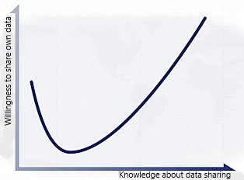
2. The Healtex Brighton Citizens’ Jury June 2018
Why use citizens’ juries?
Surveys and focus groups matter
But policy is complex
Citizens’ juries can tell us what people think when more informed and able to talk to their peers
People often change their minds…
Unhappy valley
“know a little, worry a lot”

Slide 15
What is a citizens’ jury?
A small group of people (12-24) representative of the area
Commit 2-7 days to learn about and deliberate on a complex issue (paid)
At the end they usually answer one clearly framed question
The jury hears from expert witnesses who explain all issues within the topic
They hear from advocates who represent different sides of the argument
They ask questions and discuss the issues among themselves

Slide 16
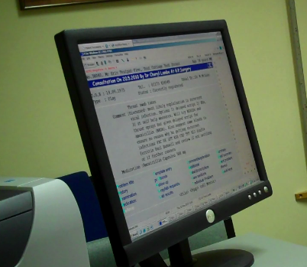
Presentations
Patient records: what they contain in codes and text, and how clinicians decide what to record.
How free text can be de-identified by computers and how successful this is.
Five processes by which information is extracted from medical free text to use for research.
Ethical issues around the use of patient data and free text specifically.
The law around the use of patient data

Slide 17
Findings from the Brighton Jury
18 participants representative of England demographics met together for 3 days
Main question: “to what degree do you support the use of free text data from patients’ records for health research?”
6 were strongly supportive, 12 were fairly supportive, 0 were neutral/unsupportive
Case Study (43 year old man with diabetes and mental health symptoms):
Should the data be shared with the university?
Coded data/ diabetes | Yes = 8 | Only if patients can opt-out = 8 | Only if patients can opt in = 2 | No = 0
Text data / diabetes | Yes = 4 | Only if patients can opt-out = 12 | Only if patients can opt-in = 2 | No = 0
Text data / mental heath | Yes = 4 | Only if patients can opt-out = 12 | Only if patients can opt-in = 2 | No = 0

Slide 18
Jury Recommendations
Culture of continuous improvement in technology to secure privacy and increase research quality
Transparency of data flows, processes and uses
Ford E, Oswald M, Hassan L, et al. 2020
J Med Ethics doi:10.1136/medethics-2019-105472
Notes:
Transparency includes
Comprehensive information for patients about all aspects of data usage : how, when, and under what conditions their free text might be processed, anonymised, coded, and analysed for research purposes.
How decisions are made about data usage.
Involving patients, e.g sitting on ethics boards.
Providing and option for people to access published research which used their data.

Slide 19
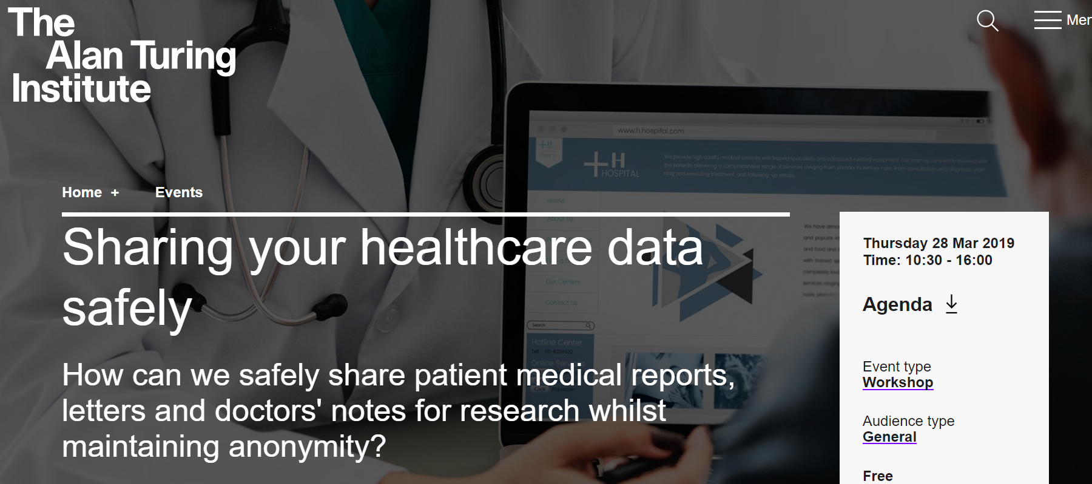
3. Turing Institute Public Event March 2019
Presentations, sketches and discussions describing: What are the special problems with sharing the written text in letters, reports, and clinic notes?
Presentation of proposed safeguards
Panel discussion and group work
“There is enormous potential of, as yet, largely underutilized free-text data for research purposes… it is an atrocious waste”
Patient representative on panel.

Slide 20
4. TexGov
Development of Data Governance Standards for Using Clinical Free-Text Data in Health Research
Outline data protection legislation and regulations relating to free text
Rapid review of governance models used for free text in UK
Engagement with public, and research community to explore barriers and solutions.
Public respondents generally positive about data being used.
Opt-out mechanisms preferred but are not granular, not specific to free text.
Importance of operating within existing frameworks for all data – free text not fundamentally different.
Need to articulate the potential benefits of research using free text.

Slide 21
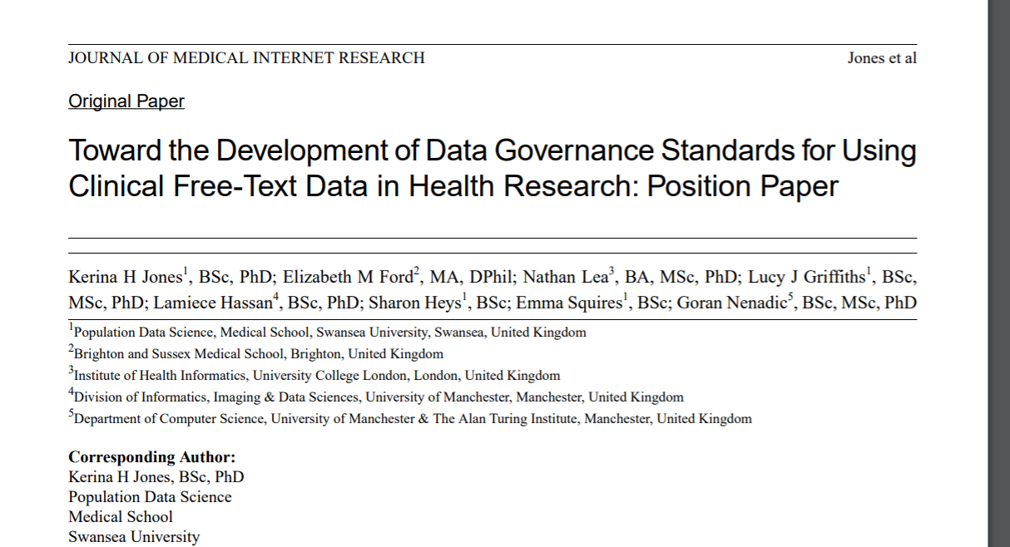

Slide 22
Recommendations
Clearer regulatory guidance based on type of data extraction and location of storage
Better information for the public
Use and results of free text data should be publicised to all stakeholders
Further improvements in deidentification and information extraction NLP
Identifier-redacted full text data should be treated as still potentially identifiable.
Governance statements for use of free text to be published
Consider creating a databank of donated/consented clinical free text.

Slide 23
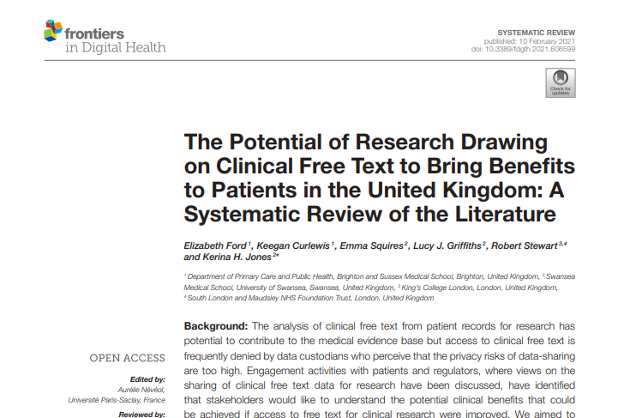
5. Patient Benefits?
Systematic review providing a summary and taxonomy of possible benefits to patients of research using free text:
Quality or service improvement
Exposure/outcome relationships
Drug prescribing safety
Clinical decision support
Identification for clinical trials

Slide 24
6. Review of public engagement in UK data governance models
Reviewed 17 UK datasets hosting NHS patient data
Reviewed 10 governance domains
Looked especially at how the public were included in:
Design and development of public facing materials, lay summaries etc
Governance of datasets
Oversight and ethics panels/committees
Development of linkage protocols
Consultation on study design, methodology, and acceptability
Test new ideas, questionnaires, provide feedback.

Slide 25
Planned work: KSS Public Deliberative Discussion groups
Funding from NIHR “Unlocking Data to Inform Public Health Policy and Practice”
£178K to spend in 9 months (!)
AIMS
1) To understand public views around integrated dataset use,
2) To inform ways of including the public in governance models regionally,
3) To explore public involvement in prioritisation and decision making for the use of data,
4) To advise on best practice for transparency and engagement with the public around data
oversight and use.

Slide 26
What do we want to ask?
What are the advantages and benefits of using these data for research and commissioning for the public?
What type of projects should be prioritised and by what mechanisms /processes should prioritisation happen?
Are there any concerns around use of datasets from a public perspective? How could these be mitigated?
How should the public be involved in the uses of these datasets?
How should we best communicate the use of datasets such as these for transparency and inclusivity?
WHAT ELSE…?

Slide 27
e.m.ford@bsms.ac.uk

