Slide 1
Kent and Medway Care Record Progress update

Slide 2
Update Endorsement and approval
The following slides provide an update to the KMCR Project Board and KMCR Project Reference Groups on progress with the KMCR project.
Endorsement of Full Business Case and Contract Award has been given by:
KMCR Reference Groups
KMCR Project Board
STP Digital and Finance Groups, Clinical and Professional Board and Local Care Board
STP Partnership Board
Approval for Full Business Case and Contract Award has been sought from and now given by:
CCG Governing Bodies
Kent County Council
Medway Council
Kent Community Health NHS Foundation Trust (KCHFT)

Slide 3
Next Steps – Contract for KMCR
The Contract is currently being finalised; the below sets out key activities to achieve signing of the contract:
Activity | Lead responsibility | Due date
Production of a detailed implementation plan for consideration by CPRG & TRG | Graphnet | 7th January 2020
Production of a proposed payment milestone schedule (including success measures) | Graphnet | 7th January 2020
Production of KPIs for year one to be focused on implementation milestones and core system performance KPIs as already defined in the Call Off Order Form | Graphnet | 7th January 2020
Final draft order form to be completed | James Gibbons - Cantium | 7th January 2020
Finance and Contract Group to receive a tabled version and presentation of the final call off order form for review and endorsement | James Gibbons – Cantium | 8th January 2020
KMCR Project Board to receive an update following FCMG for information | KMCR Project Director | 14th January 2020
TRG and CPRG to review and agree the implementation plan at the planned joint session | KMCR Project Team to CPRG and TRG | 17th January 2020
KMCR Project Board to virtually review and approve the final call off order form | Core Project Team to support | Week Commencing 20th January 2020
*Contract Variations for Providers need to be competed in readiness for new contract year | Optum to take forward | 27th January 2020
*Collaboration Agreement to be signed by all Core Organisations | Core Project Team to co-ordinate | 27th January 2020
*Contract to be issued | Core Project Team to support | Week commencing 27th January 2020
Contract to be signed | KCHFT and Graphnet | 31st January 2020
Implementation to commence | KCHFT, Graphnet and Core Project Team, Cantium | 3rd February 2020
* These actions are interdependent and need to be completed prior to contract signing

Slide 4
Next Steps
Collaboration Agreement:
Currently being finalised following approvals and will be sent out from the SRO to ICPs for signing early in January 2020
KMCR Project Board:
The SRO will continue to be Susan Acott, Chief Executive of EKHUFT.
Meetings are now diarised from January, with the first meeting of 2020 taking place on 14th January
This meeting will be used to agree TOR and formal membership for the Board for phase 3, as well as the endorsement of Chairs and underpinning Groups for the KMCR governance structure and to receive an update on progress with the Contract

Slide 5
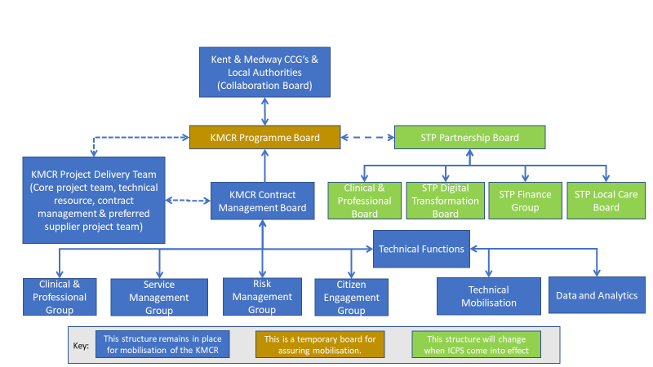
KMCR Governance Arrangements

Slide 6
Next Steps The Project Team will be seeking appropriate membership of the groups within the governance structure from all Core Organisations these are:
Acute Trusts
Dartford and Gravesham NHS Trust
East Kent Hospitals University NHS Foundation Trust (EKHUFT)
Medway Maritime Hospital - Medway NHS Foundation Trust
Maidstone and Tunbridge Wells NHS Trust
Mental Health Trusts
Kent and Medway Partnership NHS and Social Care Partnership Trust
North East London Foundation Trust
Community Providers
Kent Community Health NHS Foundation Trust
Virgin Care
Medway Community Healthcare
Other primary care providers
GPs, GP Federations and Primary Care Networks (PCNs)
SECAmb
Out of Hours providers
Commissioners
Kent and Medway CCGs
Kent County Council (children and adults services)
Medway Council (children and adults services)

Slide 7
Next Steps:
A joint meeting of the KMCR Clinical and Professionals Group and the Technical Group will take place on 17th January 2020.
This meeting will be used to review the Implementation Plan and agree how this will be taken forward through the workstreams of these two key groups

Slide 8
Next Steps:
Clinical and Professionals Group (CPRG):
The Chair will be Dr Sarah Phillips
The group will meet on a monthly basis and will be serviced by the core project team
The group will have underpinning workstreams to support delivery as follows:
Meetings are being booked for both the CPRG and underpinning workstream groups and these commence in January.
The first CPRG meeting for phase 3 is taking place on 13th February 2020 where the TOR and formal membership will be agreed
Workstream leads will be responsible for managing their meetings and for feeding back progress to the wider CPRG and KMCR Project Board as appropriate. The core project team will support the setting up of the first meeting
Work Stream | Proposed Champion / Lead
Frailty | Dr Sarah Phillips
End of Life | Dr Mark Whistler
Dementia | Dr Laurence Potter
Children’s Safeguarding | Penny Ademuyiwa
Mental Health | Dr Laurence Potter
Medication | Dr Mark Whistler – liaising with System colleagues
Frequent Attenders | Dr Mark Whistler – liaising with System colleagues

Slide 9
Next Steps:
Technical Group (TRG):
The TRG are meeting on 19th December and will be reviewing their Technical Readiness Assessment Framework (TRAF) work with Graphnet
The Chair for the Technical Group for Phase 3 will be Andy Barker
The group will meet on a monthly basis and will be serviced by the core project team
The group will have underpinning workstreams to support delivery as follows:
Workstream leads will be responsible for managing their meetings and for feeding back progress to the wider Technical Group and KMCR Project Board as appropriate. The core project team will support the setting up of the first meeting
Meetings are scheduled from January 2020, with the first meeting for phase 3 taking place on 16th January 2020, where the TOR and formal membership will be agreed
Work Stream | Proposed Lead
Data and Analytics | Andrew Brownless / Marc Farr
Technical Mobilisation | Andy Barker
Data Definitions and TRAF | Les Manley & Morfydd Williams
Information Governance | Alan Day
User Authentication & Management | Neil Perry

Slide 10
High Level objects of the Data and Analytics Work stream (extract from the FBC)
Ensure that data quality standards are met
Report to the programme board issues identified relating to data quality
Provide advice, guidance and information on data issues
Provide link between the KMCR programme and STP population health management programme
Link to the STP Business Intelligence governance group (Shared Health and Care Analytics Board)

Slide 11
Next Steps:
Contract Management Group (CMG):
The CMG are meeting on 8th January, where they will be reviewing the KMCR contract
The Chair for the Contract Management Group for Phase 3 will be Gordon Flack or other KCHFT delegated Senior Manager
The group will meet on a monthly basis and will be serviced by the core project team
Meetings are scheduled from January 2020, the first meeting will also be used to review the TOR and to agree formal membership
Other Governance Groups:
The Draft Terms of Reference for all Groups are being prepared by the core project team for discussion at the KMCR Project Board and KMCR Project Groups in January. A further discussion will be required by the KMCR Project Board at its first meeting regarding the Service Management Group and Risk Management Group

Slide 12
Next Steps
Key focus for January 2020:
Signing of Collaboration Agreement
Finalise CVs for Provider Contracts from April 2020
Further define the resource requirements for Providers articulated in the FBC
Provider IT Directors pursuing HSLI funding opportunities to support the implementation of the KMCR
Finalise and sign Contract for KMCR solution with Supplier
Establishment of the Project governance structure, including underpinning groups
Production of the PID and Project Plan
Standing up project resources across the KCHFT, Cantium and Graphnet
Production of the mobilisation and implementation plan
Development of the communications and engagement strategy and plan
Attending ICP Boards to update them about the FBC, contract award and plans for Phase 3 of the Project, to ensure understanding, engagement and buy-in, as well as present the Collaboration Agreement

Slide 13
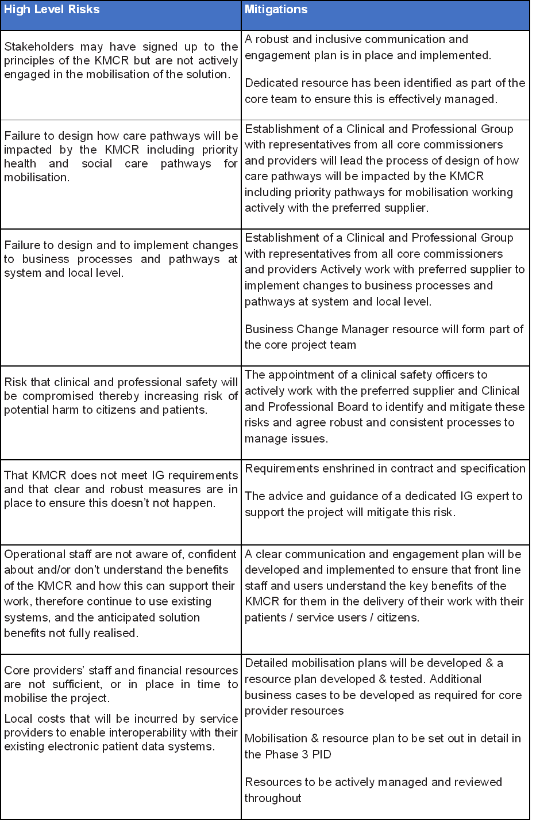
KMCR Mobilisation and Implementation High Level Risks – The below sets out some of the high level risks that have been identified. These are being developed to form a more detailed Risk and Issues Register

