Slide 1






Accidental Dwelling Fires
A Public Health Approach to Risk Factors
Produced by
Gerrard Abi-Aad – Head of Public Health Intelligence
Naomi Clemons – Senior Intelligence Analyst
Joshua Stroud – Intelligence Analyst
Richard Stanford-Beale – Kent Fire and Rescue Service
Version: 1
Last updated: Feb 2021

Slide 2
Project overview
Previous research indicated that there are a variety of factors that contribute to both the prevalence of Accidental Dwelling Fires (ADFs) and the likely outcome
Certain health related conditions lifestyles and behaviours are thought to play a role in both the cause and the outcome of ADFs although the extent to which different variables play a role is yet to be understood
This project was conducted in two stages; firstly, based on existing literature, cohorts were built based on health related factors that made them more likely to experience an ADF or die as the result of the ADF using data from the Kent Integrated Database. The distribution of these cohorts across Kent and Medway were established
Secondly the geographical profiles of those considered at risk based on health related factors were overlaid with the well established risk based model utilised by KFRS which was developed using data from historical fires
Notes:
Richard
This presentation give a brief overview of the rationale and findings from this project. The full write up, including detailed methodology can be found of the KPHO website

Slide 3
Risk Factors
Whilst certain factors can be predictive in terms of prevalence and outcome of ADFs not all predictors are of equal strength; there is likely to be a large amount of random variance due to human behaviour and activity. Despite this variance deprivation is thought to be one of the strongest predictors of ADFs¹
Fatalities
Older age, increasing from 65
Male
Non-white ethnic groups
Drug/ alcohol use
Living alone
Disability / cognitive impairments
Low socio-economic status
Under 11 years, esp under 5 years
Smokers
Non-Fatal ADF / Injury
Certain ages
certain males
Disabilities
social economic status
types of occupancy
Smoking
alcohol/drug use
previous experience of fire
Notes:
Richard & Naomi
Ref1. Hastie and Searle, 2016
Deprivation is a strong predictor
Those who are at increased risk of serious injury or death from an ADF are not at the greatest risk of having an ADF, they are two distinct groups, therefore they need to be considered separately both in term of prevention and intervention but also in terms of identification
Deprivation is associated with poor health and negative health behaviours, so it may be that deprivation is the key driver rather than health issues
Non-fatal = The research shows that these factors are more complex and harder to identify than for ADF fatalities, partly due to the lack of accurate and specific data

Slide 4
Cohorts
Cohort one: fatal – elderly criteria: aged 65 and over, living in a single person household
Cohort two: fatal – child: single parent households, with multiple children under the age of 11 living in an area of high deprivation
Cohort three: ADFs and non fatal causalities: males, aged between 40 and 64, living in a single person household
Whilst these key factors formed the basis for inclusion in one of the three cohorts, further risk segmentation was applied to further narrow down the impact of various health related conditions and behaviours
Notes:
Naomi
Whilst the cohorts had key factors on which they were formed they were further segmented based on a combination of risk factors

Slide 5
Risk Segmentation
Additional risk factors for Cohort One include:
LTCs
MH/Depression
IMD decile 5 or below
Cohort Two – no further risk segmentation was conducted
It was not possible to identify multiple children under the age of 11 residing with a lone parent.
Data extracted included the count of children aged under 18 residing in a household with a single parent recorded as a smoker
Additional risk factors for Cohort Three include:
LTCs
MH/Depression
IMD decile 5 or below
Smoking history
Notes:
Naomi
Both Cohort one and cohort three were segmented into very high risk, high risk and medium risk based on the combination of additional risk factors based on health related conditions, behaviours and deprivation
e.g. very high risk for cohort one were individuals aged over 65 with three or more LTCs residing in an area with an IMD decile score of 1 - 5
very high risk for cohort three were individuals aged between 45 and 64 with three or more LTC, with a marker for MH or depression, having ever been recorded as a smoker residing in an area with an IMD decile 1 - 5

Slide 6
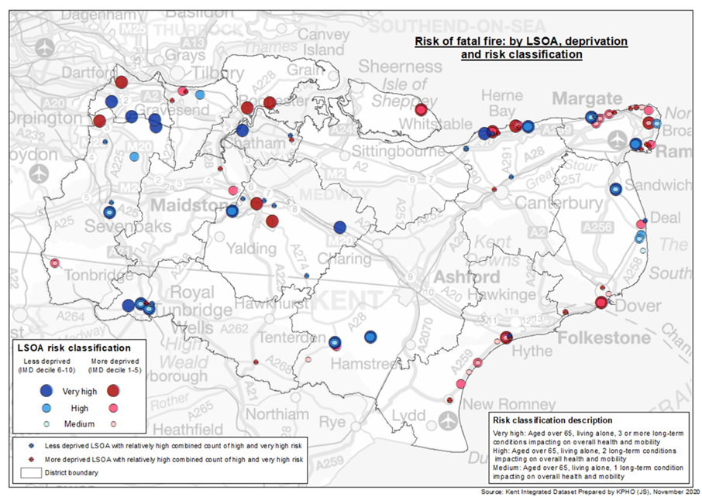
Geographic Spread - Example
Notes:
Naomi
Data was analysed to provide district overview but was mapped at LSOA level for more granular detail

Slide 7
Role of health in ADF risk and outcome
To establish the predictive capability of health based conditions and behaviours the health based cohorts were overlaid with the KFRS risk model at LSOA level to identify overlap
To allow for the different risk segmentations within in cohorts, LSOAs identified as part of the health based cohorts were weighted accordingly based on the level of risk identified within each LSOA. This was to ensure that any overlap between the two models was based on health behaviours and conditions rather than the clustering of certain populations in specific area
With no direct comparison between two different approaches to predicting ADFs having been conducted before, the nature of the relationship between various health factors and ADFs was unknown. Statistical analysis conducted to look for the strength of the association between the two models
Notes:
Naomi/Josh

Slide 8
Key Findings
For all three of the health-based cohorts there was overlap with the KFRS predictive risk model indicating that health-based factors may go some way in helping predict likelihood and outcome of ADFs
The overlap was smallest for cohort two which was unsurprising due to the issues with available data.
However, where there was overlap, this was characterized by high levels of deprivation, three or more children in a single parent household, increase smoking prevalence
Notes:
Josh

Slide 9
Key Findings
Cohort One (elderly fatal) saw the second biggest overlap with the KFRS predictive model
Deprivation proved to be a key indicator along with the presence of three or more LTCs impacting on overall health
Only 5% were recorded as having dementia or a severe mental health issue, however it seems likely that those with the advanced stages of these conditions were likely to receive help in the home, with the potential for under-recording of milder/early stages
Cohort Three saw the largest overlap with the KFRS predictive model
As with the other two cohorts deprivation proved to be a key indicator
Smoking behaviours, severe mental health conditions and depression were also prevalent, yet the prevalence of multiple LTCs was low suggesting that the relationship with conditions impacting on mobility and overall health are less important when compared to Cohort One
Notes:
Naomi

Slide 10
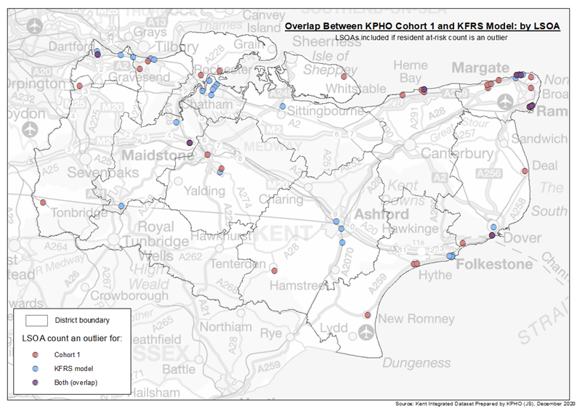
Key Findings

Slide 11
Summary and Next Steps
Health conditions and behaviours can play a role in the prevalence and outcome of ADFs, although there is a lack of clarity around the impact of different combinations of health conditions and outcome. Certain ‘at risk’ groups are more easily identifiable compared to others
Deprivation plays a key role in poor health therefore it is unsurprising that this features as a key factor, deprivation is also a key risk factor for ADFs
Identifying ‘at risk’ groups based on health related data allows for better targeting of fire service safe and well visits a key part of not only preventing ADFs but supporting independent living and quality of life by identifying individuals that may need increased levels of support
There are clear benefits in relation to sharing data between both health and fire services; PHE have shown an interest in this work and are hoping to explore the role of health conditions and behaviours on a national level in combination with fire data
Moving forward it is hoped that opportunity to map historic ADFs at UPRN level, via the KeRNAL, will allow analysts to establish a more specific combination of health, social and environment factors that contribute to the prevalence and outcome of ADFs
Notes:
Naomi

