Slide 1
Ai Based Predictive Risk Scoring for early diagnosis of Lung Cancer

Slide 2
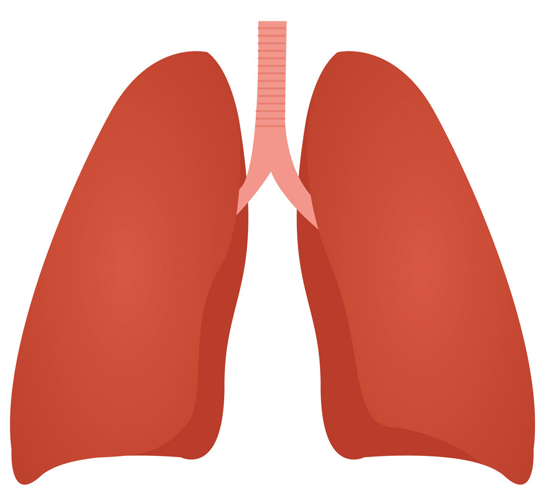
Background
Lung cancer has one of the worst rates for early diagnosis for all cancers. This has become significantly worse during COVID.
There are no precision screening methods in place that provide economic benefit to the healthcare system.
Current attempts made to improve early cancer diagnosis, involve diagnostically evaluating large volumes of individuals with less than 1% of successful case identification.
Kent and Medway – A local Review:
Evaluation benchmarking of early diagnosis of cancer was undertaken in conjunction with NHS England and identified significant variations in early diagnosis of lung cancer (B. Pollington)
An approach was needed to proactively identify individuals at risk of developing this disease.
Meeting took place 18 months ago between NHSE, County Council and STP representatives with Quantum to better understand capabilities for the use of Ai in improving healthcare.
ScHAB agreed to the overarching principles of the project and a DPIA was completed
Quantum Presented to the Cancer Alliance
Then followed the COVID-19 outbreak!

Slide 3
Our collaborative work to date
To date, a number of Kent and Medway system partners in combination with a local SME (Quantum) and NHS England, have jointly bid for several funding pots to support the development of an Ai based approach for the early diagnosis of Lung Cancer.
We have developed an extensive programme plan with the aspiration to develop an Artificial Intelligence based class IIa medical application.
Feedback has been very positive, but both times suggested that we needed to have better worked up a scalable model in place on real world data across multiple footprints.

Slide 4
What we are progressing today…
We are working collaboratively with partners to develop an initial risk tool for the K&M system for these Ai based algorithms, based upon some initial feasibility studies from the Surrey footprint.
This will put us in a much stronger position for future bids to develop a clinical application; Indeed there are a multitude of funding streams to take forward working prototypes for Ai/Machine learning use cases in healthcare.
Want to build upon the good work that has already been undertaken in Dartford and Gravesham NHS FT (Radiology AI) as well as the effort put in locally to improve the Infoflex data

Slide 5
Workplan Structure
There are two phases to the development of this workplan.
Phase 1: Will seek to build upon initial feasibility studies undertaken in Surrey as well the literary evidence that has already been collated from national studies such as the Health Lung programme and Cancer Research UK, for application to the Kent and Medway population. Within Phase 1, statistical analysis and clinical/academic evaluation will take place to identify the most effective biomarkers from health and care data that are the best predictors for lung cancer for the local Kent and Medway population. We will utilise the KID to undertake these feasibility studies given its maturity and longitudinal dataset over a 5 year period.
Phase 2: Will build upon phase 1, developing the AI based algorithms for risk scoring patients for development of lung cancer. During this stage, we will incorporate cancer staging data to improve the overall accuracy of the model and utilise the real time data within KERNEL.

Slide 6
Datasets Required
From initial feasibility studies within the Surrey Footprint, the initial scope of the data required is a longitudinal record of pseudonomised linked patient level data with a minimum of 3 years in duration covering the following health and care settings:
Phase 1
Primary Care (Events, Appt, LTC Registers and Medications, Death)
Secondary Care (A&E, Inpatient and Outpatients, Critical Care)
Mental Health (Inpatient and Outpatient History)
Community Care (Contacts, Appointments, MIU, WIC)
Social Care Data Optional
Wider Determinants of Health
Phase 2
Infoflex
Dartford and Gravesham AI Diagnostics tool Optional

Slide 7
Next Steps
Discuss Data Quality and Completeness of datasets for use (2nd March)
Seek IG approval again through the SHcAB and agree data access (15th March)
Agree funding and clinical stakeholder oversight into the project via the Cancer Alliance (22nd March)
Commence Programme of work (1st April onwards).

